Slide 1
TOPOLOGIES
Topology of a neural network refers to the way the Neurons are connected, and it is an important factor in network functioning and learning. A common topology in unsupervised learning is a direct mapping of inputs to a collection of units that represents categories

Slide 2
CONCEPT
The most common topology in supervised learning is the fully connected, three-layer, feedforward network (see Backpropagation, Radial Basis Function Networks). All input values to the network are connected to all neurons in the hidden layer (hidden because they are not visible in the input or the output), the outputs of the hidden neurons are connected to all neurons in the output layer, and the activations of the output neurons constitute the output of the whole network. Such networks are popular partly because theoretically they are known to be universal function approximators (with e.g., a sigmoid or gaussian.

Slide 3
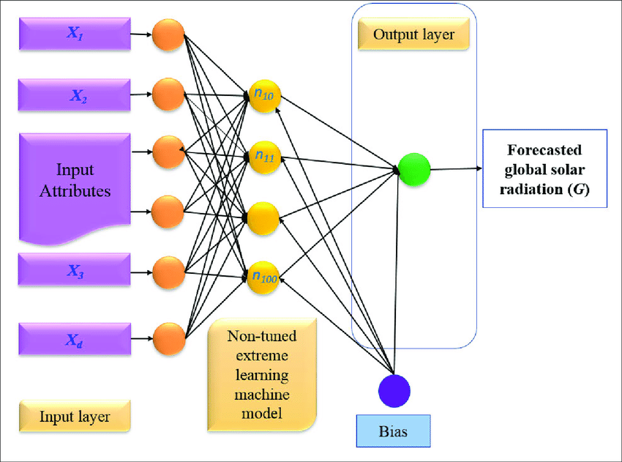
CONCEPT

Slide 4
There are two types of Neural Network topologies − FeedForward and Feedback.
FeedForward
In this , the information flow is unidirectional. A unit sends information to other unit from which it does not receive any information. There are no feedback loops. They are used in pattern generation/recognition/classification. They have fixed inputs and outputs.
FeedBack ANN
Here, feedback loops are allowed. They are used in content addressable memories.

Slide 5
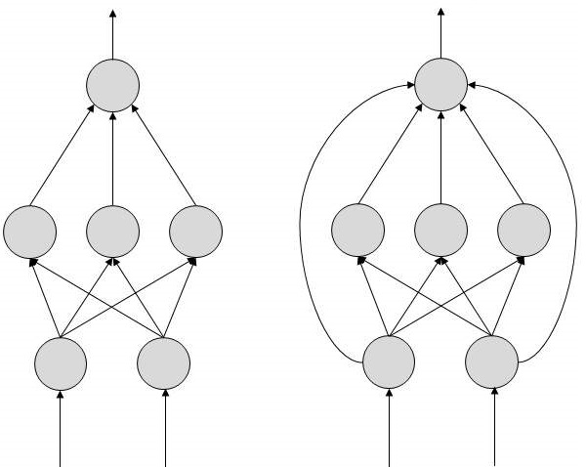
Working: In the topology diagrams shown, each arrow represents a connection between two neurons and indicates the pathway for the flow of information. Each connection has a weight, an integer number that controls the signal between the two neurons. If the network generates a “good or desired” output, there is no need to adjust the weights. However, if the network generates a “poor or undesired” output or an error, then the system alters the weights in order to improve subsequent results.

